Slide 1
Blusting Confidence
Hello everyone, we will start soon

Slide 2
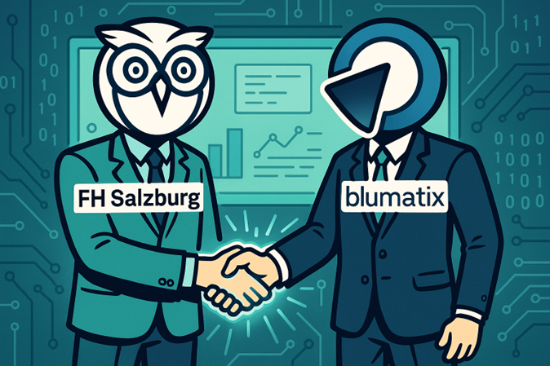
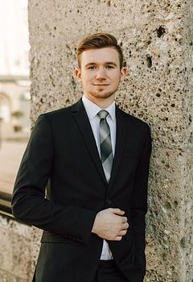
Cooperation Blumatix - FH Salzburg
Who Jonas Kubesch from FHS Blumatix staff
What Improving confidence scores for LLM document-field extraction
Previous cooperations
GenTextAI https://realities.fh-salzburg.ac.at/projects/gentext/
Self-learning RAG

Slide 3
What’s coming
01
02
03
04
Current state
Short description on why this cooperation was started
Proposed solution
Theoretical explanation
Architecture
High-level overview
Results and Demo
What works, and what does not
05
Future Works

Slide 4
01
Current state
“I want my 99.99% confidence (-_-*)

Slide 5
Current state
The need for certainty
Current system
Self-confidence for LLMs
Customers want to rely on the provided output – but what if the LLM is not sure about it?
Currently scores are only internal - the customer received a fixed confidence
Various papers suggest that self-assessments are quite good – use them!

Slide 6
Blumatix x FH Salzburg
How well are LLMs, namely the GPT-5 series, doing in rating their own output for correctness?

Slide 7

02
Proposal
Think Chatty – THINK!

Slide 8
Self-Certainty through Chain-of-Thought (CoT) reasoning
Reasoning Models
Newer LLMs have built in thinking modes, breaking down complex problems and exploring thoughts like a human would
CoT
Reasoning = Confidence
Yoon et al. (2025) state that these reasoning models are better at estimating their answer’s confidence score
Reasoning = Cost
However, more reasoning = more tokens = higher cost, is it worth it?

Slide 9
Ideas
Weighted majority voting
Utilize collective intelligence
Multiple reasoning paths are explored → different answers
The most frequent and confident answer is likely the correct one
Token probability observation
How likely is the next token?
Inspect token probability to find reasoning inconsistencies (causes of errors)
Disclaimer: Due to API restrictions this was found to be (currently) impossible

Slide 10
Blumatix x FH Salzburg
Let the LLM think about its own output.
A good output should also be distinguishable as such

Slide 11
03
Architecture
So, how does one do the deed?

Slide 12
Pipeline – LLM POV
Initial instructions
Solution Reasoning
Confidence Reasoning
You get briefed about the task (System prompt)
Think about the provided document and find the answer
Think about how sure you are about your answer
Decision
Compare to Groundtruth
Provide your answer and your confidence score to the user
(Fuzzy) compare your solution against the ground truth

Slide 13
Reasoning traces – Step 1
"reasoning": { "step1": "Plan and findings (concise, non-sensitive):
- Classification: Document contains clear invoice indicators ("Rechnung", invoice number, VAT, totals, line items). No exclusion terms dominating. Proceed as invoice.
- Locate fields:
- Invoice.Date: found "Datum 06.04.2023".
- Sender.VatId: header shows "VAT Registration n° ATU39103108" and footer repeats "ATU39103108".
- Grand total: table shows "Gesamtsumme brutto (EUR) 1.875,74" – gross total appears as 1.875,74 EUR.
- VAT group: VAT rate shown as "20,00 %" with corresponding VAT amount "312,62" and net amount "1.563,12".
- Net.Amount: 1.563,12 (matches net column).
- Vat.Amount: 312,62.
- Vat.Rate: 20 (remove % per rule).
Notes on formats and rules: - Numeric formats use comma as decimal separator in source; final numeric values must preserve decimals but as numbers (keep decimal precision).
No fields are being inferred beyond explicitly present values.
- If multiple matches existed, would include multiple entries; here single VAT group present.",

Slide 14
Reasoning traces – Step 2
"reasoning": {
"step2":
"Invoice.Date — 95% — "Datum 06.04.2023" appears explicitly.
Sender.VatId — 95% — "VAT Registration n° ATU39103108" shown in header and footer.
GrandTotal.Amount — 90% — "Gesamtsumme brutto" shown as 1.875,74 EUR in totals table (clear gross total).
Vat.Rate — 95% — VAT rate shown explicitly as "20,00 %".
Net.Amount — 95% — Net amount listed as 1.563,12 in totals table
corresponding to the 20% VAT group.
Vat.Amount — 95% — VAT amount listed as 312,62 corresponding to the 20% VAT group."
},

Slide 15
Weighted Majority Voting
1.95
0.98
17
17
17
20
0.97
1.00
10
10
1.00
20
0.85
1.64
0.79
20
20

Slide 16
04
Results
We can confidently say that …

Slide 17
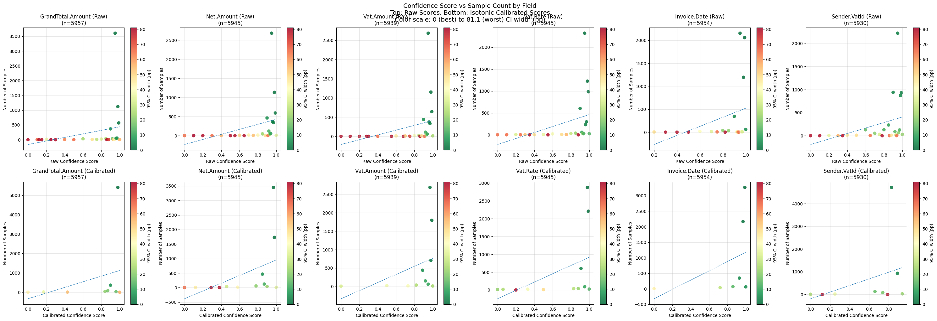
… more = better …
Legend
Color: Confidence interval size
x-Axis: Confidence
y-Axis: Number of Samples

Slide 18
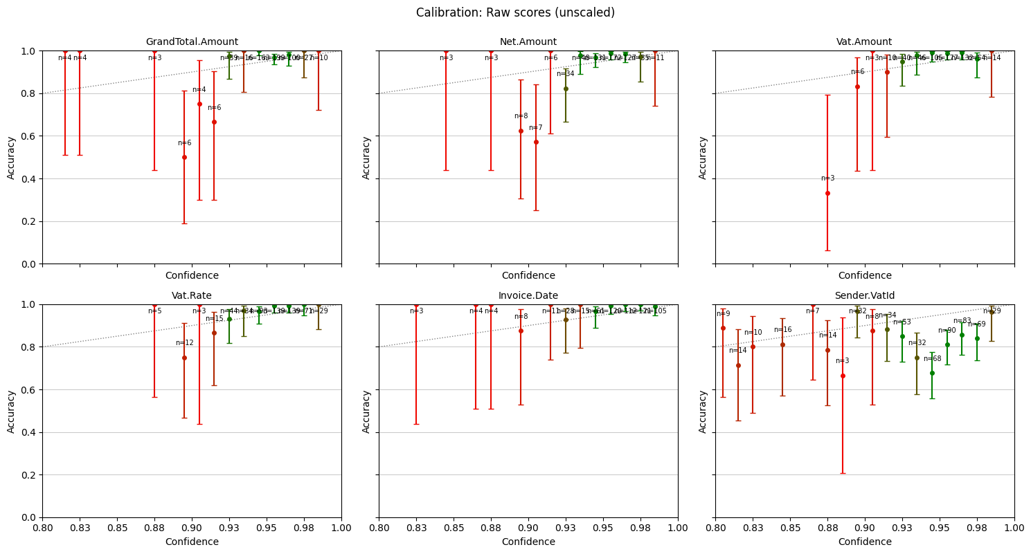
… so take this …
Legend
Whisks =95% Confidence interval
Color = Number of samples
x-Axis = Confidence
y-Axis = Accuracy

Slide 19
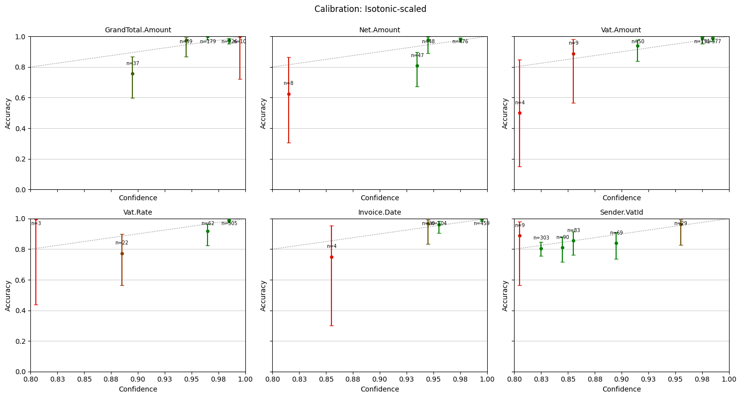
… and transform it to this!
Legend
Whisks =95% Confidence interval
Color = Number of samples
x-Axis = Confidence
y-Axis = Accuracy

Slide 20
Also observable here
Legend
Color: Confidence interval size
x-Axis: Confidence
y-Axis: Number of Samples

Slide 21
ECE
BRIER
AUROC
Calibration correctness
Probabilistic accuracy of predictions
Probability curve for correctly labeling samples

Slide 22
Results
 | ECE Δ | Brier Δ | AUROC Δ
GrandTotal.Amount | -0.0211 | 0.0004 | 0.0008
Invoice.Date | -0.0179 | 0.0000 | -0.0708
Net.Amount | -0.0215 | -0.0018 | 0.0054
Sender.VatId | -0.0910 | -0.0117 | 0.0277
Vat.Amount | -0.0234 | -0.0010 | -0.0205
Vat.Rate | -0.0168 | -0.0001 | -0.0135
Average | -0.032 ✓ | -0.0024 ✓ | -0.0118 X

Slide 23
Blumatix x FH Salzburg
The LLM does not know exact values!
But we can adjust its judgment quite well

Slide 24
05
Future Works
What can we use this for?

Slide 25
Future Works
Logprobs
More documents
Wait for the release of logprobs in Azure
Downside: Not available for GPT-5 per design
More documents = better calibration
Increase the number of samples per bin

Slide 26
Literature
Self-confidence through CoT
Wang, X., Wei, J., Schuurmans, D., Le, Q., Chi, E., Narang, S., ... & Zhou, D. (2022). Self-consistency improves chain of thought reasoning in language models. arXiv preprint arXiv:2203.11171.
Yoon, D., Kim, S., Yang, S., Kim, S., Kim, S., Kim, Y., ... & Seo, M. (2025). Reasoning models better express their confidence. arXiv preprint arXiv:2505.14489.
Log-Probabilities
Fu, Y., Wang, X., Tian, Y., & Zhao, J. (2025). Deep think with confidence. arXiv preprint arXiv:2508.15260.
Kang, Z., Zhao, X., & Song, D. (2025). Scalable best-of-n selection for large language models via self-certainty. arXiv preprint arXiv:2502.18581.
Calibration of self-confidence
Xie, J., Chen, A. S., Lee, Y., Mitchell, E., & Finn, C. (2024). Calibrating language models with adaptive temperature scaling. arXiv preprint arXiv:2409.19817.
Other possible sources for calibration: - Isotonic regression - Platt scaling

Slide 27
The End

Slide 28
Thanks!

Slide 29
9h 55m 23s
333,000
386,000 km
Jupiter’s rotation period
The Sun’s mass compared to Earth’s
Distance between the Earth and the Moon

Slide 30
Introduction
Mercury is the closest planet to the Sun and the smallest one in the entire Solar System. This planet’s name has nothing to do with the liquid metal, since Mercury was named after the Roman messenger god. Mercury’s surface is filled with craters
Mercury takes a little more than 58 days to complete its rotation, so try to imagine how long days must be there! Since the temperatures are so extreme, albeit not as extreme as on Venus, Mercury has been deemed to be non-habitable for humans

Slide 31
—Someone Famous
“This is a quote, words full of wisdom that someone important said and can make the reader get inspired”

Slide 32
Introduction to AI
Definition
Advantages
Mercury is the closest planet to the Sun and the smallest in the Solar System—it’s a bit larger than the Moon
Venus has a beautiful name and is the second planet from the Sun. It’s hot and has a poisonous atmosphere

Slide 33
AI and ethics
Transparency
Privacy
Legal
Mercury is the closest planet to the Sun and the smallest one of them all
Venus has a beautiful name and is the second planet from the Sun
Despite being red, Mars is actually a cold place. It’s full of iron oxide dust

Slide 34
AI and society
Impact
Healthcare
Despite being red, Mars is very cold
Neptune is the smallest planet
Education
Government
Jupiter is the biggest planet of them all
Saturn is a gas giant and has several rings

Slide 35
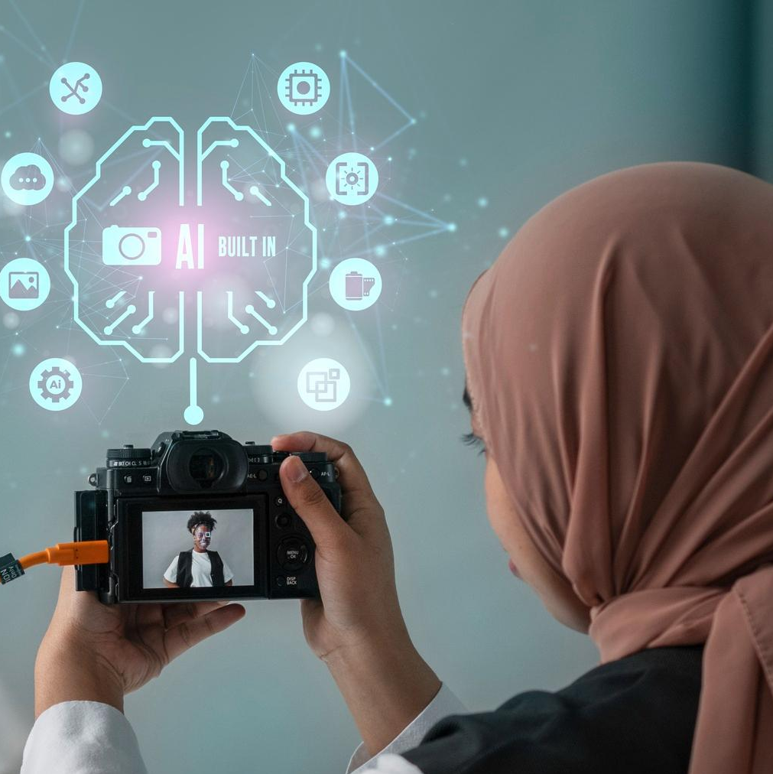

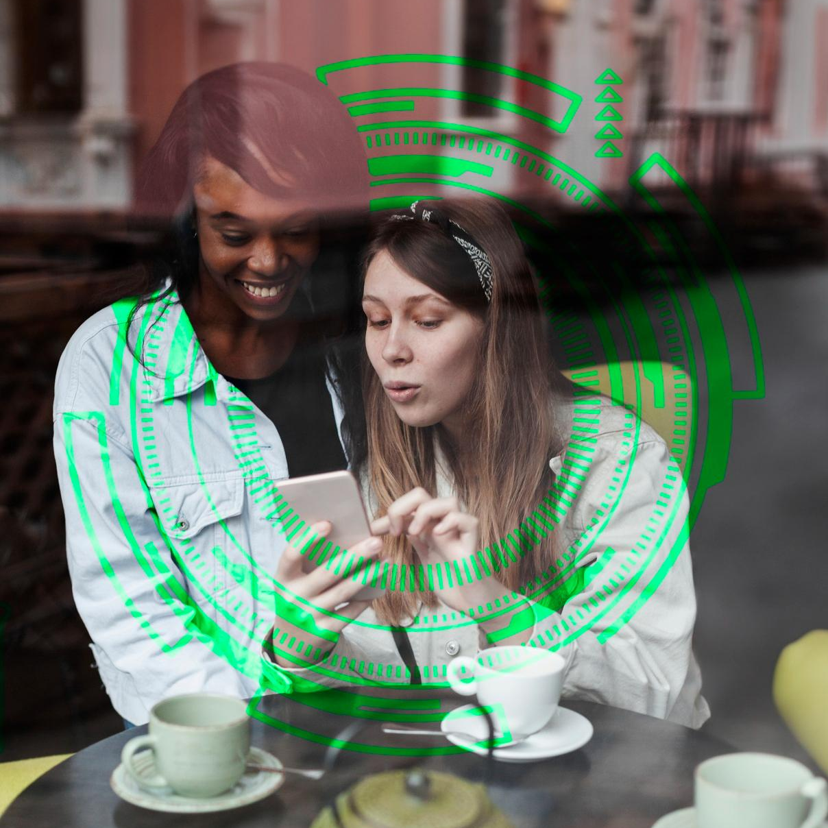
Examples
Business
Entertainment
Social
Mercury is the closest planet to the Sun and the smallest one of them all
Venus has a beautiful name and is the second planet from the Sun
Despite being red, Mars is actually a cold place. It’s full of iron oxide dust

Slide 36
AI and business
Applications
Models
Role of data
Despite being red, Mars is very cold
Venus is the second planet from the Sun
Neptune is the farthest planet from the Sun
Ethics
Customer
Future
Mercury is the closest planet to the Sun
Saturn is a gas giant and has several rings
Jupiter is the biggest planet of them all

Slide 37
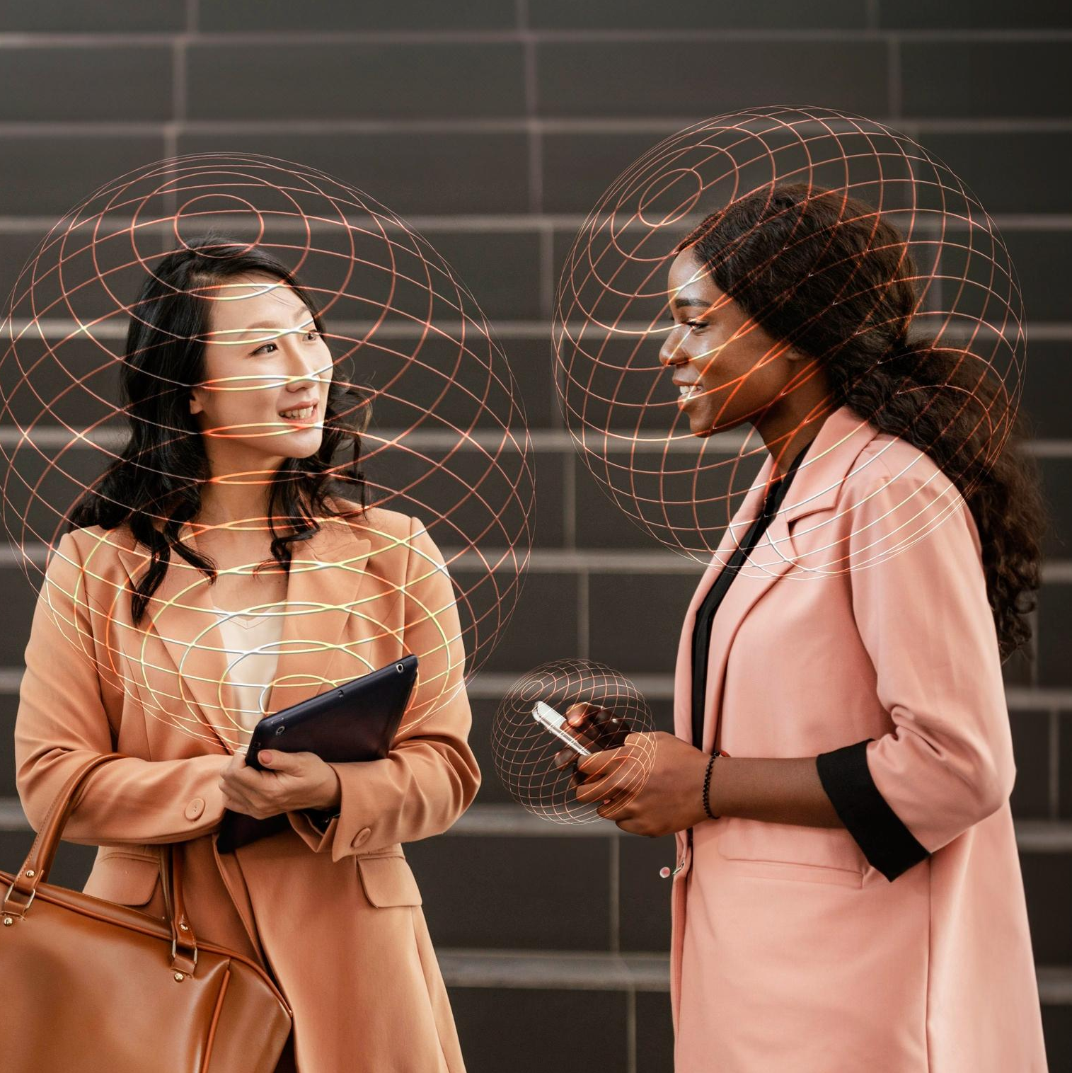
A picture always reinforces
the concept
You can give a brief description of the topic you want to talk about here. For example, if you want to talk about Mercury, you can say that it’s the smallest planet in the entire Solar System

Slide 38
4,498,300,000
Big numbers catch your audience’s attention

Slide 39
Awesome words

Slide 40
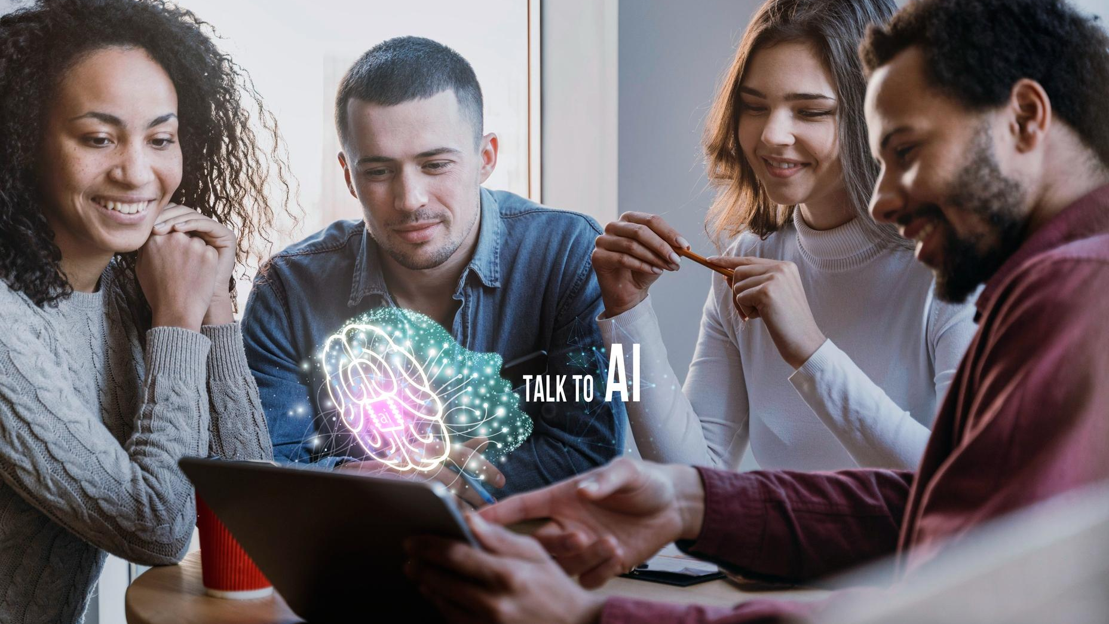
A picture is worth a thousand words

Slide 41
Improve your cybersecurity for AI
Mercury is the closest planet
Mercury is very small
Mercury has a thin atmosphere
Mercury takes 59 Earth days

Slide 42
KWL (brainstorming)
What I know | Mercury is the closest planet to the Sun
 | Despite being red, Mars is a very cold planet
What I want to know | Venus is the second planet from the Sun
 | Jupiter is the biggest planet of them all
What I learned | Saturn is composed of hydrogen and helium
 | Neptune is the farthest planet from the Sun

Slide 43
Advanced threat detection
Risk
Mercury is the closest planet to the Sun and the smallest one in the Solar System
Threat detection
Anomaly
Despite being red, Mars is actually a cold place. It’s full of iron oxide dust
Troubles
Venus has a very beautiful name and is the second planet from the Sun

Slide 44
AI and transportation
Monitoring
Predictive
Despite being red, Mars is actually a very cold place
Neptune is the farthest planet from the Sun
Reduce waste
Advantages
Future
Mercury is the closest planet to the Sun
Saturn is a gas giant and has several rings
Jupiter is the biggest planet of them all

Slide 45
Steps to apply AI in schools
Identify
Collect data
Choose AI tool
Mercury is the closest planet to the Sun
Venus is the second planet from the Sun
Despite being red, Mars is actually a cold place
Train the tool
Evaluate
Refine
Jupiter is the biggest planet of them all
Saturn is composed of hydrogen and helium
Neptune is the farthest planet from the Sun

Slide 46
Classification of AI
Reactive machines | Limited memory | Theory of mind | Self-aware conscious
Small Red Cold Rocky | Small Hot Dry Volcanic | Small Hot Rocky Cratered | Large Cold Gassy Striped
Despite being red, Mars is actually a cold place | Venus is extremely hot, even more than Mercury | Mercury is the smallest planet of them all | Jupiter is the biggest planet of them all

Slide 47
Cause and effect
Environment
People
Measurement
Mercury is the closest planet to the Sun
Mars is actually a very cold place
Saturn is a gas giant and has several rings
Problem or goal
Venus is the second planet from the Sun
Jupiter is the biggest planet of them all
Neptune is the farthest planet from the Sun
Materials
Methods
Machines

Slide 48
Theory of mind
Why is important the theory of mind?
Is Mercury the closest planet to the Sun and the smallest one in the Solar System? Note that it’s a bit larger than the Moon
Understand the mind of humans
Venus has a beautiful name and is the second planet from the Sun. It’s hot and has a poisonous atmosphere

Slide 49
Evolution of AI
20XX
20XX
20XX
20XX
Venus is the second planet from the Sun
Mercury is the closest planet to the Sun
Despite being red, Mars is a very cold
Jupiter is the biggest planet of them all

Slide 50
Parts and whole
The whole object
Parts of the object
What happens if the parts are missing?
Mercury is the closest planet to the Sun and the smallest one in the entire Solar System. This planet’s name has nothing to do with the liquid metal
Mercury
Venus has a beautiful name and is the second planet from the Sun
Mars
Saturn
What’s the function of the parts?
Venus
Saturn is a gas giant and has several rings. It’s composed of hydrogen and helium
Jupiter

Slide 51
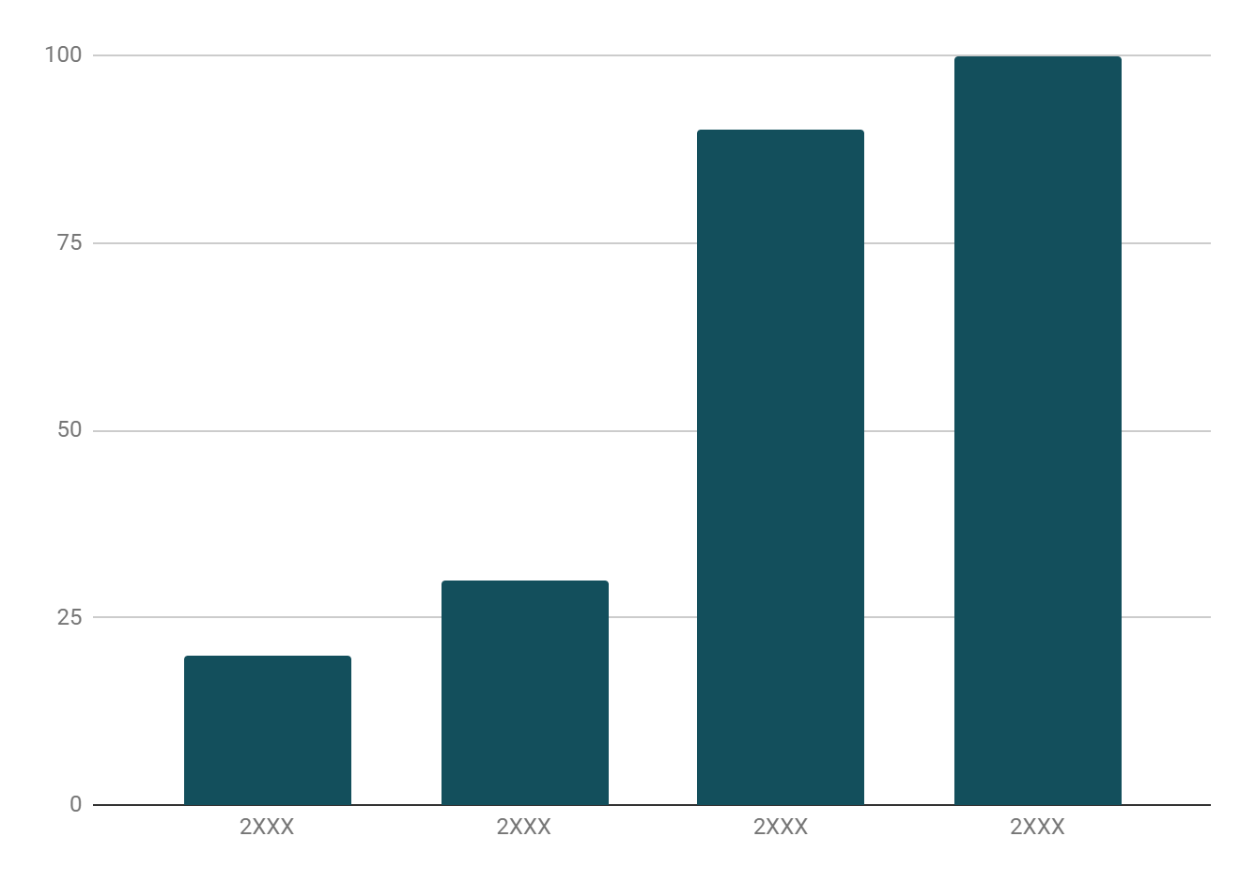
Evolution of domestic AI
Evolution
Mercury is the closest planet to the Sun and the smallest one in the entire Solar System. This planet’s name has nothing to do with the liquid metal
Follow the link in the graph to modify its data and then paste the new one here. For more info, click here

Slide 52
Where is AI being studied
Universities
Venus is the second planet from the Sun
Institutions
Mercury is the first planet from the Sun

Slide 53
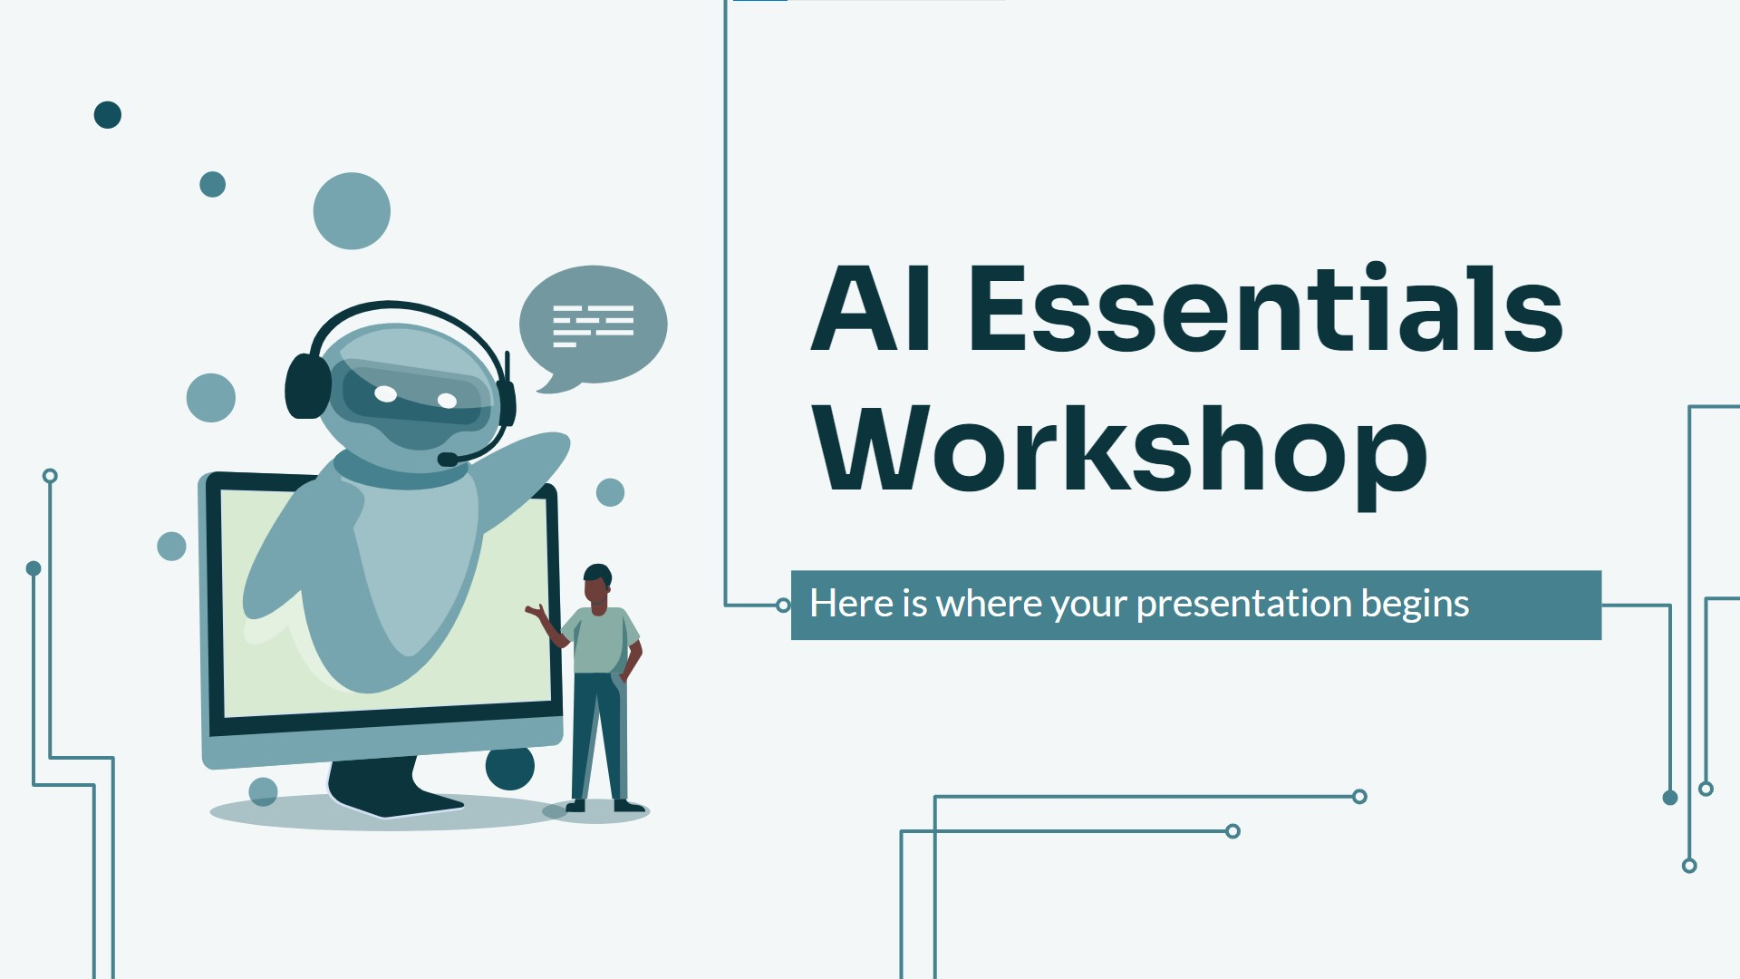
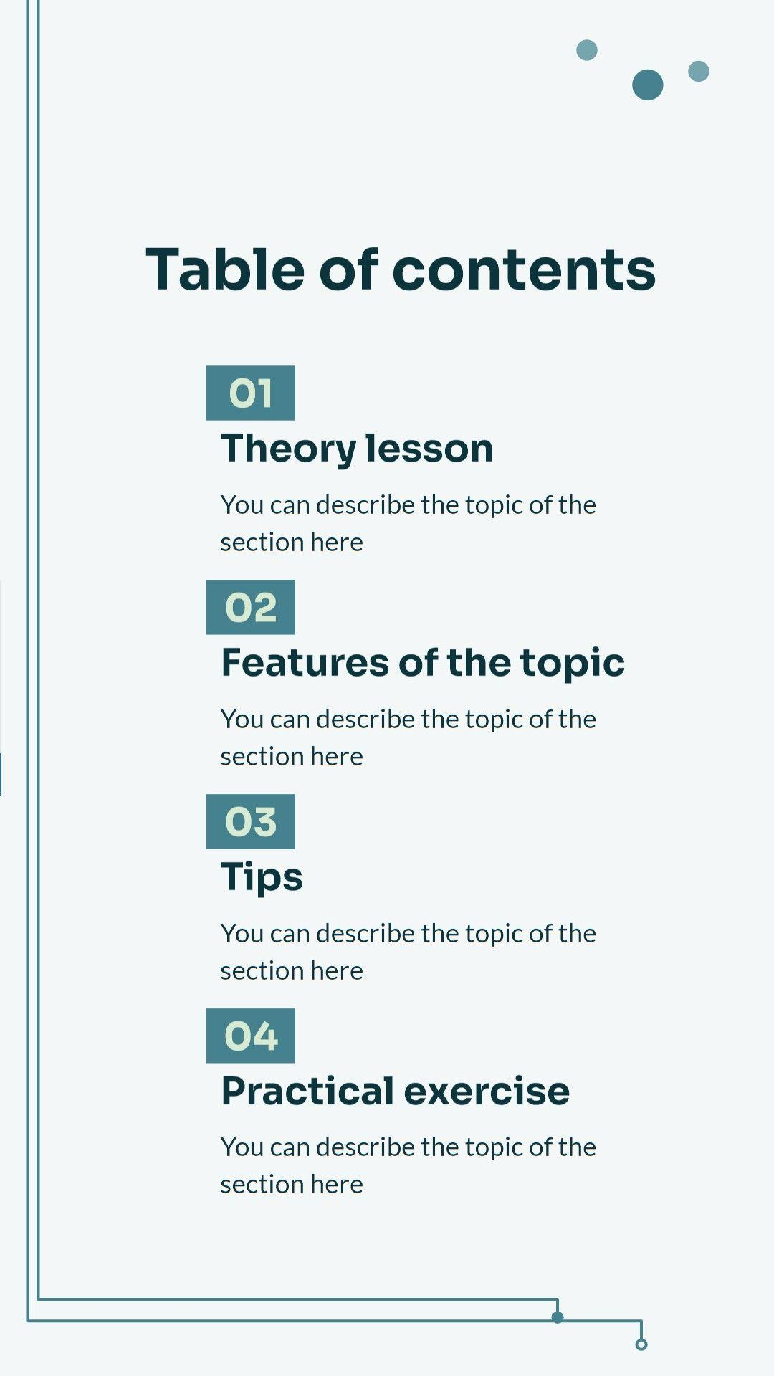
Mockups
You can replace the images on the screen with your own work. Just right-click on them and select “Replace image”

Slide 54
Thanks!
Do you have any questions?
youremail@freepik.com
+34 654 321 432
yourwebsite.com
Please keep this slide for attribution

Slide 55
Icon pack

Slide 56
Alternative resources
Here’s an assortment of alternative resources whose style fits the one of this template:
Gradient quantum illustration
Landing page artificial intelligence template
Template artificial intelligence landing page

Slide 57
Resources
Did you like the resources in this template? Get them at these websites:
Vector
Gradient npl illustration
Gradient quantum illustration
Gradient quantum illustration I
Gradient ssl illustration
Gradient sql illustration
Gradient sql illustration I
Gradient npl illustration
Photos
Woman with phone doing face scan
Person using ai tool at job
Automatic recognition software analyzing everyday subjects
Automatic recognition software analyzing everyday subjects I
Person using ai tool at job
Icons
Icon Pack: Artificial intelligence | Filled

Slide 58
Instructions for use
If you have a free account, in order to use this template, you must credit Slidesgo by keeping the Thanks slide. Please refer to the next slide to read the instructions for premium users.
As a Free user, you are allowed to:
Modify this template.
Use it for both personal and commercial projects.
You are not allowed to:
Sublicense, sell or rent any of Slidesgo Content (or a modified version of Slidesgo Content).
Distribute Slidesgo Content unless it has been expressly authorized by Slidesgo.
Include Slidesgo Content in an online or offline database or file.
Offer Slidesgo templates (or modified versions of Slidesgo templates) for download.
Acquire the copyright of Slidesgo Content.
For more information about editing slides, please read our FAQs or visit our blog:
https://slidesgo.com/faqs and https://slidesgo.com/slidesgo-school

Slide 59
Instructions for use (premium users)
As a Premium user, you can use this template without attributing Slidesgo or keeping the "Thanks" slide.
You are allowed to:
Modify this template.
Use it for both personal and commercial purposes.
Hide or delete the “Thanks” slide and the mention to Slidesgo in the credits.
Share this template in an editable format with people who are not part of your team.
You are not allowed to:
Sublicense, sell or rent this Slidesgo Template (or a modified version of this Slidesgo Template).
Distribute this Slidesgo Template (or a modified version of this Slidesgo Template) or include it in a database or in any other product or service that offers downloadable images, icons or presentations that may be subject to distribution or resale.
Use any of the elements that are part of this Slidesgo Template in an isolated and separated way from this Template.
Register any of the elements that are part of this template as a trademark or logo, or register it as a work in an intellectual property registry or similar.
For more information about editing slides, please read our FAQs or visit our blog:
https://slidesgo.com/faqs and https://slidesgo.com/slidesgo-school

Slide 60
Fonts & colors used
This presentation has been made using the following fonts:
Sora
(https://fonts.google.com/specimen/Sora)
Lato
(https://fonts.google.com/specimen/Lato)
#0c343d
#f3f7f8
#134f5c
#45818e
#76a5af
#d9ead3
#88ada5
#f3f3f3
#ffffff

Slide 61



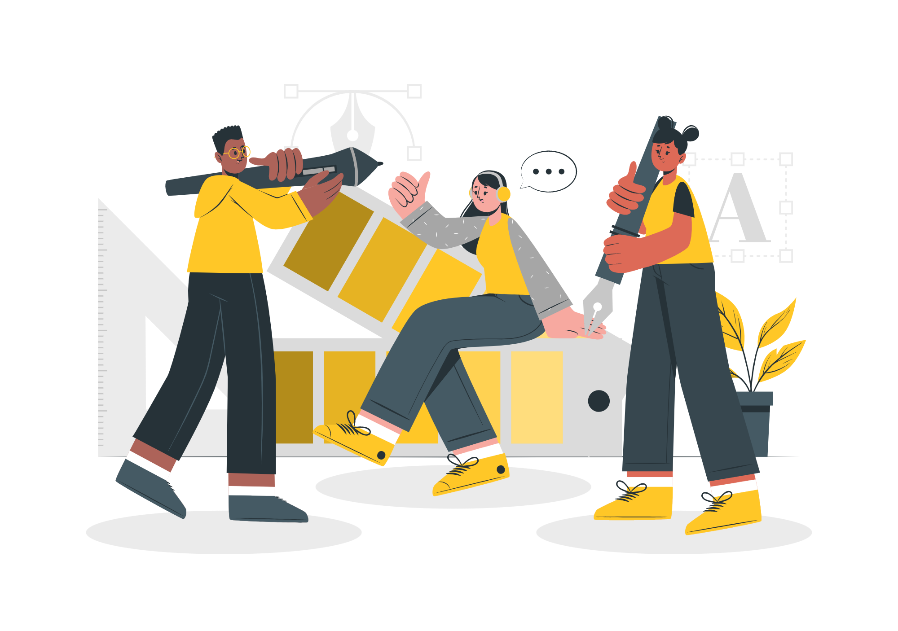

Storyset
Create your Story with our illustrated concepts. Choose the style you like the most, edit its colors, pick the background and layers you want to show and bring them to life with the animator panel! It will boost your presentation. Check out how it works.
Pana
Amico
Bro
Rafiki
Cuate

Slide 62
Use our editable graphic resources...
You can easily resize these resources without losing quality. To change the color, just ungroup the resource and click on the object you want to change. Then, click on the paint bucket and select the color you want. Group the resource again when you’re done. You can also look for more infographics on Slidesgo.

Slide 65
JANUARY
FEBRUARY
MARCH
APRIL
MAY
JUNE
PHASE 1
Task 1
Task 2
PHASE 2
Task 1
Task 2
JANUARY
FEBRUARY
MARCH
APRIL
PHASE 1
Task 1
Task 2

Slide 68
...and our sets of editable icons
You can resize these icons without losing quality.
You can change the stroke and fill color; just select the icon and click on the paint bucket/pen.
In Google Slides, you can also use Flaticon’s extension, allowing you to customize and add even more icons.

Slide 69
Educational Icons
Medical Icons

Slide 70
Business Icons
Teamwork Icons

Slide 71
Help & Support Icons
Avatar Icons

Slide 72
Creative Process Icons
Performing Arts Icons

Slide 73
Nature Icons

Slide 74
SEO & Marketing Icons

Slide 75


